Slide 1
Design and Analysis of Algorithms
CS202

Slide 2
Today’s class
Asymptotic Notation
Local minimum exercises
Loop Invariants

Slide 3
Find the input size
Input: x, y in {1,2,…,n}. Output: xy
2 log_2 n
Input: A,B: n by n matrix. Output: AB (n^2)
Input size: 2n^2 (number of elements)* size of each element (measured in bits)

Slide 4
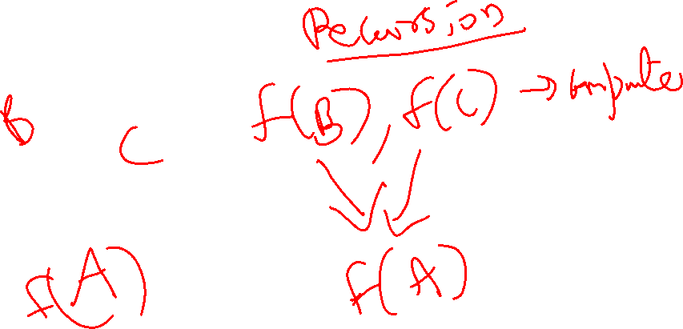

Divide & Conquer Strategy

Slide 5




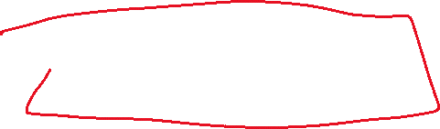








Slide 6















































E.g. 1:
Given a positive integer n, find √n.
i=1
While (i*i<n)
Increment I
Return (i-1)

Slide 7

E.x. 1:
Finding a local minimum’
3,7,0,-2,12,8,10,1,4,2
A local minimum is an element A[i] such that it is:
A[i]<=A[i-1] and A[i]<=A[i+1]

Slide 8



















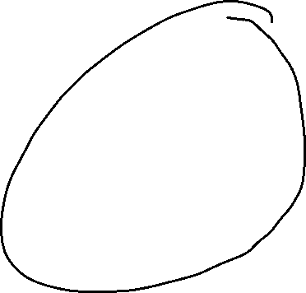















Algorithm for local minimum
Compare the middle element with its neighbors to check if it is a local minimum.
Suppose it is not.
A[mid] > A[mid-1] or A[mid]>A[mid+1] (or both)
Recursively search in one of the two halves.

Slide 9

If A[mid+1]<A[mid], then the right half of the array contains at least one local minimum.
Proof:
The smallest element of the right half is a local minimum.

Slide 10
Algo to find local minimum
Compare middle element with its neighbors. If it is the local minimum, we are done.
Else if A[mid-1]<A[mid], then recursively search in A[first,mid-1]
Else (A[mid+1]<A[mid]), recursively search in A[mid+1,last]

Slide 11



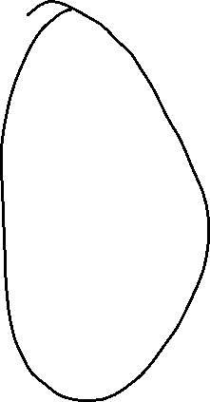







Algo to find local minimum
First=1,last=n
While (first<last)
If A[mid] is a local minimum, return mid.
Else if A[mid-1]<A[mid], set last=mid-1
Else if A[mid+1]<A[mid], set first=mid+1
Return first.

Slide 12
Algo for standard binary search: A[1]<=…<=A[n] and x
First=1,last=n
While (first<last)
If (x=A[mid), return mid.
Else if x<A[mid], set last=mid-1
Else if x>A[mid], set first=mid+1
If (x=A[first]) return first, else return Not found.
Modify it to find the least index I such that A[i]<=x
2,4,6,8,10,12 and x=11. Output: 5

Slide 13







































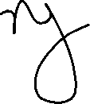



Slide 14


































Slide 15
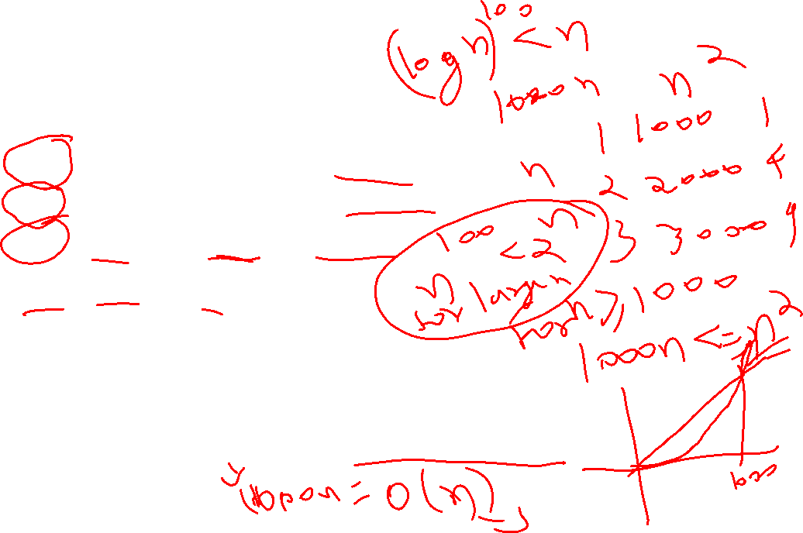
Asymptotic Notation: Examples
4n^2+5n-10 = O(n^2)
n^3-n^2+5n+6 = O(n^3)
n^2+nlog n + sqrt(n) = O(n^2)
2^n+n^10+log n =O(2^n)
log n=o(n); n=o(n^2); n^2=o(2^n)
F(n)=O(g(n)) f(n)<=cg(n) for sufficiently large n

Slide 16
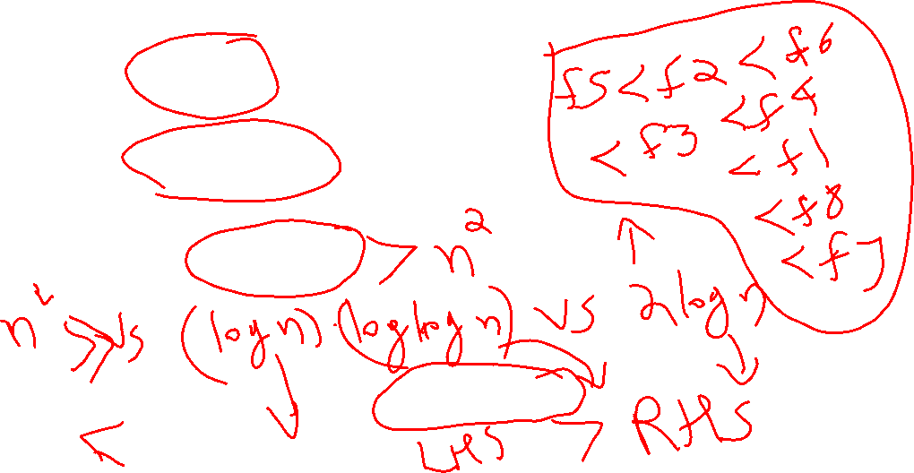
Asymptotic Notation: Arrange in increasing order
n²+n 2. log² n 3. n/log n
5n+4 5. log log n 6. √n
7. 2^{n} 8. (log n) ^{log n}
Sqrt(n) vs n/log n 1 vs sqrt(n)/log n

